Slide 1

Search 2

Slide 2
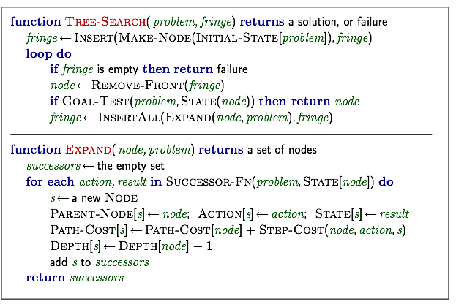
Previously...
note the time of goal-test: expanding time not generating time

Slide 3
Uninformed Search
Informed Search
Beyond Classical Search
Adversarial Search

Slide 4
Informed Search Strategies
best-first search: f but what is best?
uniform cost search: cost function g
heuristic function: h
g(n)
h(n)
n
initial state
current state
goal state

Slide 5
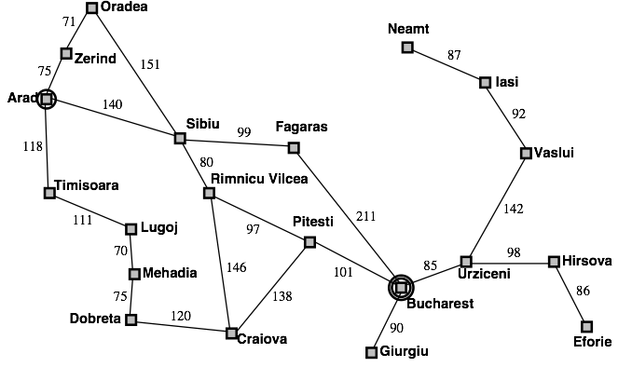
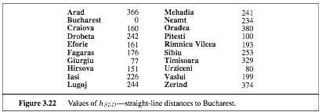
Example: hSLD

Slide 6
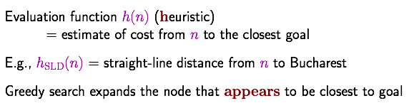
Greedy search

Slide 7

Example

Slide 8
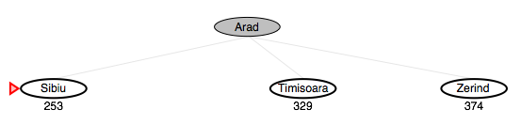
Example

Slide 9
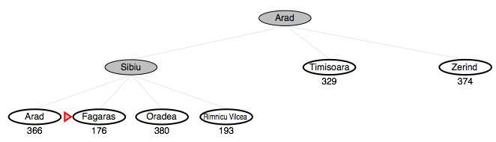
Example

Slide 10
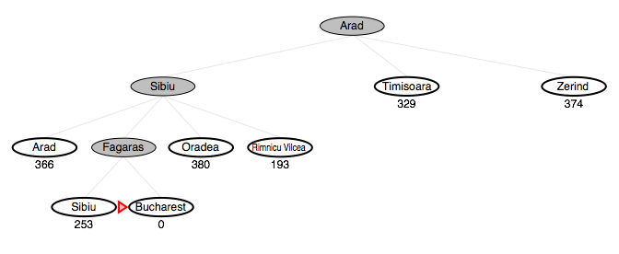
Example

Slide 11
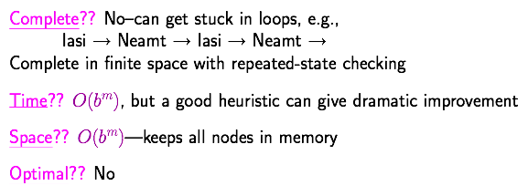
Properties

Slide 12
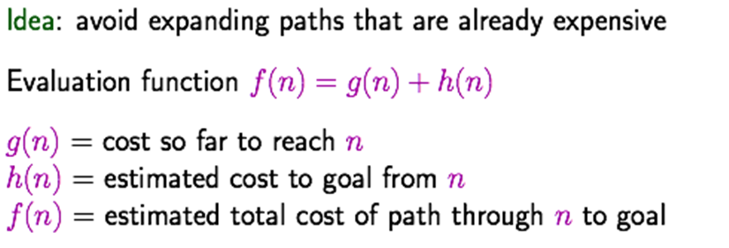
A* search

Slide 13

Example

Slide 14
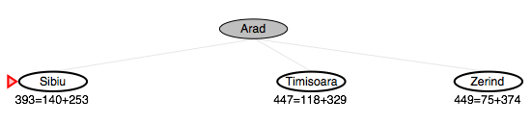
Example

Slide 15
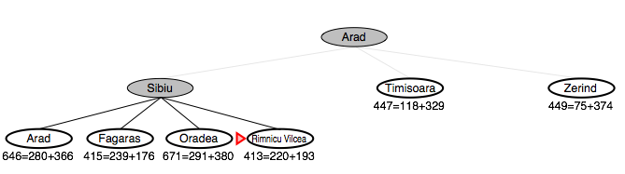
Example

Slide 16
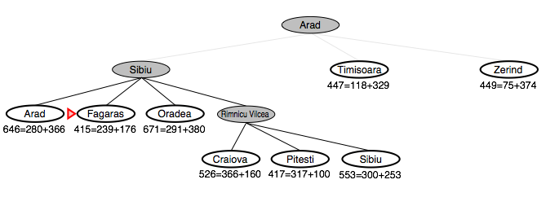
Example

Slide 17
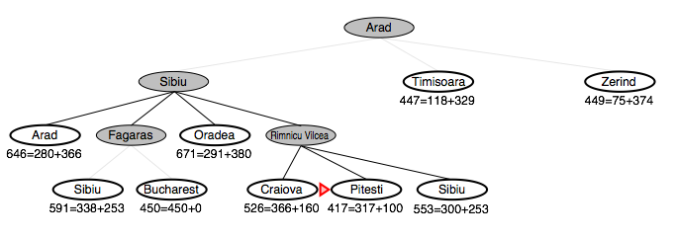
Example

Slide 18
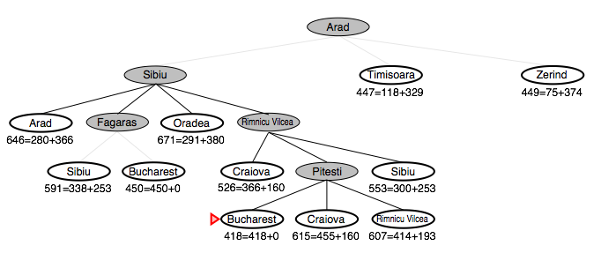
Example

Slide 19
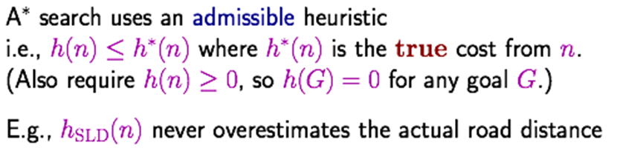
Admissible heuristic

Slide 20
Admissible heuristic
Admissible: never over estimate the cost
g(n)
h(n)
n
initial state
current state
goal state
no larger than the cost of the optimal path from n to the goal

Slide 21
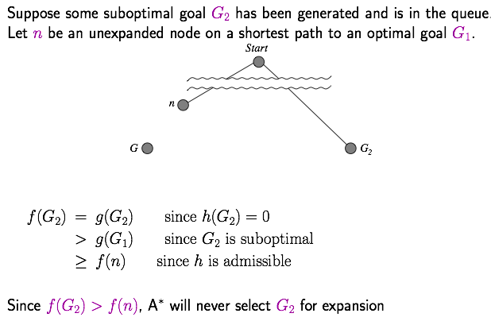
Admissible heuristic
A* of tree search is optimal with admissible heuristic
solution

Slide 22
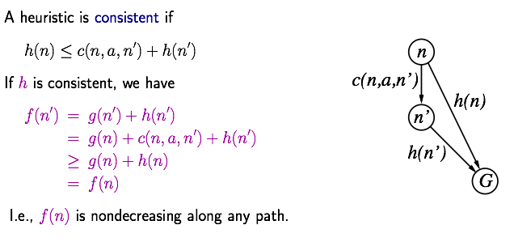
Consistent heuristic

Slide 23
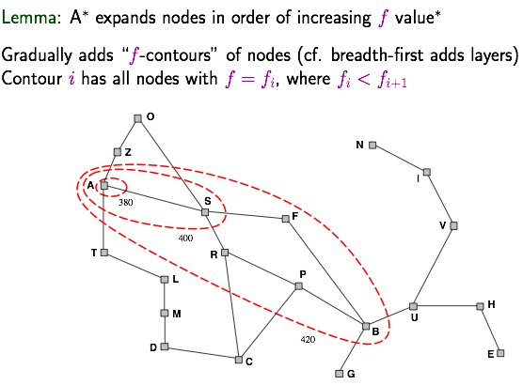
Consistent heuristic
A* of graph search is optimal with consistent heuristic

Slide 24
Homework
1. Prove that if a heuristic is consistent, it must be admissible.
2. Give an example of heuristic, which is admissible but not consistent.
3. Judge whether the following result is true. Prove your argument.
A* of graph search is optimal with admissible heuristic
https://cs.stackexchange.com/questions/23351/optimality-of-a?rq=1

Slide 25
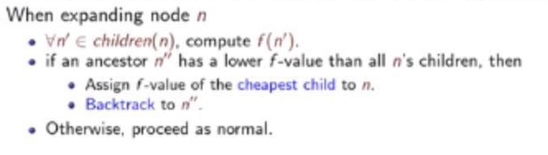
Variants of A*
Iterative Deepening A* (IDA*)
For less space complexity
Problematic when the heuristics are real-valued
Recursive Best-First Search (RBFS)
A simple recursive algorithm that mimics standard best-first search using only linear space
DFS, where each node on the current path remembers the best f-value of any alternative path from its ancestors
视频：3-4和3-5

Slide 26
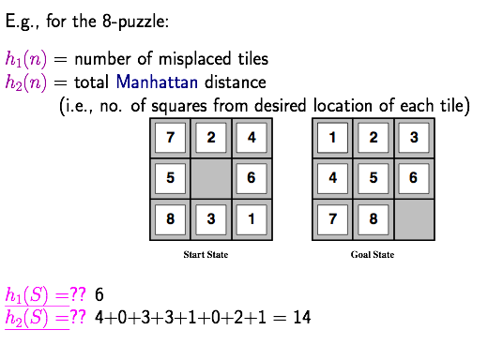
Example of heuristic
Origin of Manhattan distance

Slide 27
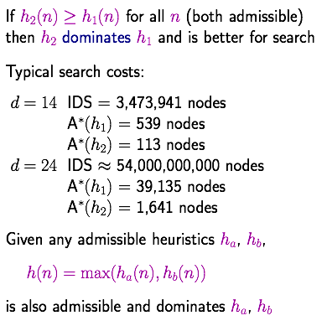
Dominance
A* using h₂ never expands more nodes than using h₁ if h₂ dominates h₁ (h₁ and h₂ are admissible, not required to be consistent)
Formal proof needed.

Slide 28
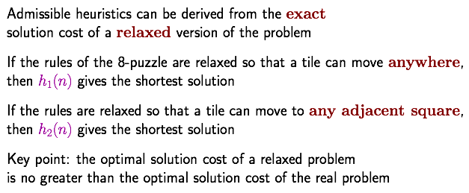
Admissible heuristics from relaxed problem

Slide 29
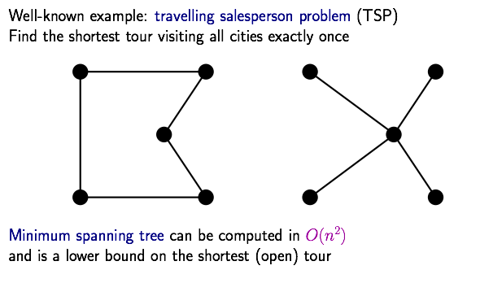
Example of problem relaxation

Slide 30
Generating heuristics from sub-problems and experiences
Sub-problems
8-puzzle: move only 1,2,3,4
The sum of heuristics from multiple sub-problems may not be admissible
Experiences
Linear sum of multiple heuristics
Weights are learnt by regression with the support of ground truth
视频3.6

